Slide 1



Welcome to:
With special thanks to our sponsors, DSBN and Savage Data

Slide 2
🚀 Power Up Your Data Skills
The Utility Advisor
Analyzing Green Button Data for Real‑World Decisions

Slide 3
🎯 Mission: Utility Advisor
Parse the raw energy file
Calculate costs
Recommend best $ plan
Build UI
Show cool graphs
Show useful alerts

Slide 4

🔌 Green Button XML Data
Standard utility data format
Complex machine-readable XML
You extract only what matters

Slide 5
🔬 Inside a Single Record
• <value>: consumption (kWh)
• <start>: timestamp → EST
• <tou>: pricing tier code

Slide 6
🧠 Strategy of the Provided Code
Split at BREAK
1
Track when inside a record
2
Extract start, value, tou
3
Store clean data
4

Slide 7
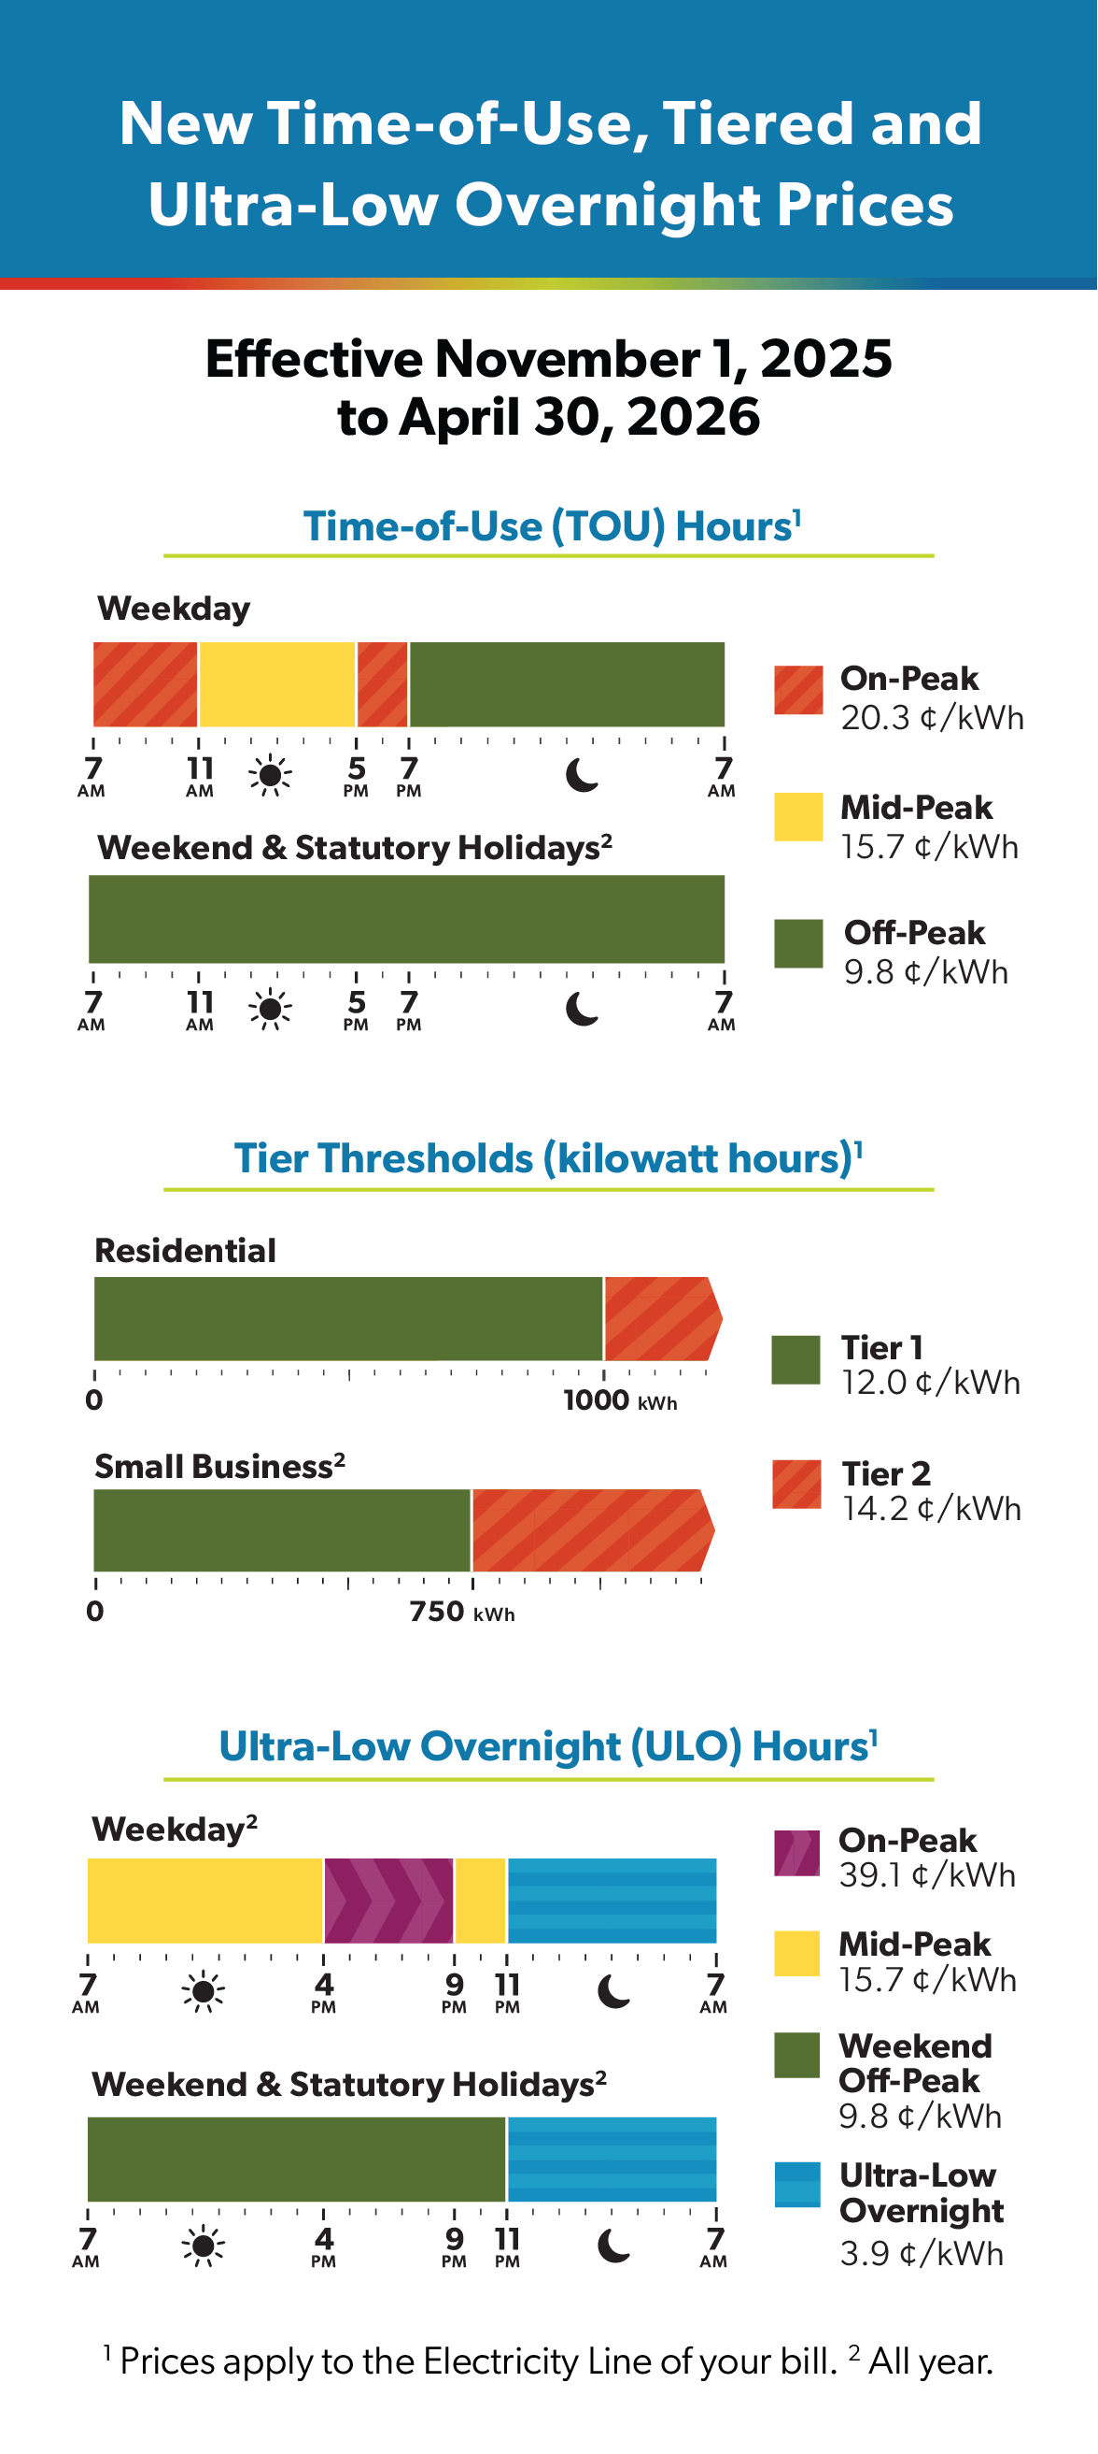
💲 Pricing Tiers
Energy-Use Rates
Time Of Use (TOU): 1 = High, 2 = Medium, 3 = Low
Tiered Billing
Ultra‑Low Overnight (ULO)
Which one is the best for you? Save $$$, help your neighbor!

Slide 8

⚠️
Usage Spike Alerts
Data
User inputs time range + threshold
Alert when kWh exceeds limit at certain times
Graphs and Data

Slide 9

🏆Point System
Functionality 10
User Experience 10
Recommendation Engine 20
Alerts 20
Graphs 20
Documentation 10
Presentation (top 3 teams) 10
Collaboration 5
Top Team Chooses First!

Slide 10

What Now?
Find your stations and log in
Go to MarkElgersma.com and get some starter code
Plan out what your program will look like and do
Use Divide and Conquer with your team
Bathrooms and a water filling station are right and then left
Enjoy a pizza lunch at 11:20 – enjoy it in room 120 at the tables with stools
3:15pm to 3:45pm – initial judging begins to rank teams
4pm – all assemble in room 121 for presentations from top teams (3-5 min each)
4:15 – Prizes selections
4:30 – Until next time

